Slide 1
TCS NQT Placement Questions

Slide 2
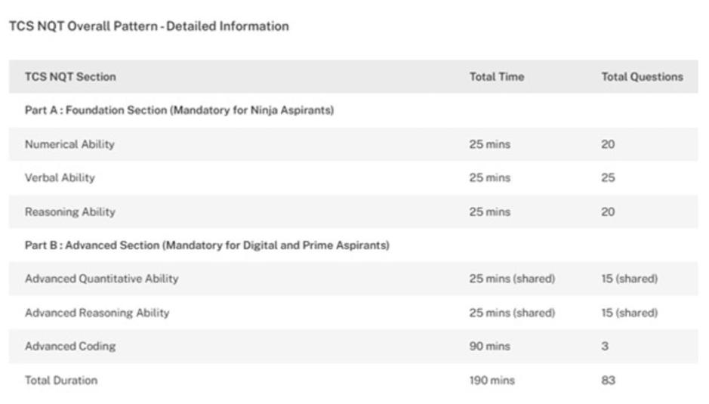
TCS NQT Overall Pattern

Slide 3
Aptitude Topics
Mixtures
Profit & Loss
Time & Work
Speed, Time & Distance
Simple Interest
Ratio & Average

Slide 4
Reasoning Topics
Letter Patterns
Series
Odd One Out
Cube Problems
Coding-Decoding

Slide 5
APTITUDE Q1) 6 litres of pure milk is added to 10 litres of a mixture of water and milk, with 40% milk. What is the percentage of milk in the new solution? 1. 50% 2. 62.5% 3. 75% 4. 87.5%
Answer: Option 2
Explanation:
Initial milk = 10 × 40% = 4 L.
After adding 6 L pure milk, milk = 4 + 6 = 10 L.
Total volume = 10 + 6 = 16 L.
Percentage = (10/16)×100 = 62.5%.

Slide 6
Q2) There are 20 litres of mixture of water and milk with 30% milk. How many litres of pure milk must be added to make the ratio water:milk = 1:1? 1.14L 2. 6L 3. 8L 4.10 L
Answer: Option 3
Explanation:
Initial milk = 20×30% = 6 L; (20-6=14 water)
water = 14 L.
Need milk such that 14:(6 + x) = 1:1 →
14 = 6 + x → x = 8 L.

Slide 7
Q3) In a mixture there is 26% water. After replacing 7 litres of the mixture by 7 litres pure milk, the percentage of milk becomes 76%. What is the total quantity of the mixture? 1. 65 L 2. 91 L 3. 38 L 4. None
Answer: Option 2
Explanation: After removing 7L of mixture
Replaced with 7l of pure milk
Final water=100%-76%=24%
Intitial water=0.26x
Water removed with 7l of mixture:0.26*7
Final volume of water in the mixture:0.24x
0.26x-(0.26*7)=0.24x
0.26x-0.24x=0.26*7
0.002x=1.82
X=1.82/0.02
X=9l

Slide 8
Q5) The cost price of a chair is ₹240. The shopkeeper gives 10% discount on the marked price and still makes a profit of ₹30. What is the marked price? 1. ₹360 2. ₹330 3. ₹390 4. ₹300
Answer: Option 4
Explanation:
CP = 240, profit 30 → SP = 270.
SP = 90% of MP → MP = 270/0.9 = ₹300.

Slide 9
Q6) Two articles are sold at the same price. One is sold at 75% profit and the other at 30% loss. What is the overall result? 1. 22.5% profit 2. 57.5% profit 3. 13 2/7 % loss 4. None of these
Answer: Option 4
Explanation:
1st article
SP=CP1(1+75/100)
175=CP1*1.75
CP1=175/1.75=100 units
2nd article
SP=CP2(1-30/100)
175=CP2*.70
CP2=175/0.70=250 units
Total cost=CP1+CP2=100+200=350 units
Total selling price=175+175=350 units
No profit or loss
If both sold at same SP S: CP1 = S/1.75,
CP2 = S/0.7.
Total CP = S(1/1.75 + 1/0.7)
= S(0.5714 + 1.4286) = 2S.
Total SP = 2S → no overall profit or loss.

Slide 10
Q7) A trader sells two articles, one at 10% loss and another at 15% profit but overall there is no gain or loss. If total sale price of both articles is ₹30,000, find the difference between their cost prices. 1. ₹5,000 2. ₹6,000 3. ₹7,500 4. None of these
Answer: Option 2
Explanation:
0.10*CP1=0.15*CP2
CP1/CP2=0.15/0.10=3/2
CP1=3x, CP2=2x
3x+2x=30000
5x=30000
X=6000

Slide 11
Q8) A vendor buys oranges at ₹2 for 3 oranges and sells them at ₹1 each. To make a profit of ₹10, how many oranges must he sell? 1. 10 oranges 2. 20 oranges 3. 30 oranges 4. 40 oranges
Answer: Option 3
CP of 3 oranges=2
SP of 3 oranges=3*1=3
Profit on 3 oranges=sp-cp=3-2=1
Required oranges-3*10=30 oranges

Slide 12
Q9) A goes 10 km at 6 km/h and the remaining 20 km at 15 km/h. What is A’s average speed for the whole journey? 1. 10 km/h 2. 12 km/h 3. 13 km/h 4. 14.5 km/h
Answer: Option 1
T1=D/S
10/6 =5/3 h
T2=D/S
20/15=4/3 h
5/3+4/3=9/3=3 h
Total distance=10+20=30km
Avg speed=TD/TT
=30/3=10km/h

Slide 13
Q10) A train 100 m long runs at 30 km/hr. Time to pass a man standing near the line is: 1. 15 sec 2. 12 sec 3. 14 sec 4. 16 sec
Answer: Option 2
D=100m
S=30km/hr
S=30*5/18m/s
150/18=25/3 m/s
T=D/S
T=100/(25/3)
T=100*3/25
T=4*3=12 sec

Slide 14
Q11) A train 240 m long crosses a telegraph post in 16 seconds. The speed of the train is: 1. 50 km/h 2. 51 km/h 3. 52 km/h 4. 54 km/h
Answer: Option 4
Explanation:
Speed = 240 m / 16 s = 15 m/s
= 15×18/5
= 54 km/h.

Slide 15
Q12) A train 300 m long runs at 25 m/s. Time to cross a bridge of 200 m is: 1. 15 sec 2. 20 sec 3. 18 sec 4. 16 sec
Answer: Option 2
Explanation:
Distance to cover = 300 + 200 = 500 m.
Time = 500 / 25 = 20 s.

Slide 16
Q13) A train takes 18 s to pass a platform 162 m long and 15 s to pass another platform 120 m long. The length of the train is: 1. 40 m 2. 80 m 3. 90 m 4. 95 m
Answer: Option 3
Explanation:
Let L be train length.
S=D/T
Speed = (L + 162)/18 = (L + 120)/15.
Solve: 15(L + 162) = 18(L + 120)
→ L = 90 m.

Slide 17
Q14) A works alone in 10 days; B alone in 20 days. If both work together, how many days to finish the work? 1.10 days 2. 6 days 3. 6 2/3 days 4. 7 1/2 days
Answer: Option 3
Explanation:
Combined rate = 1/10 + 1/20 = 3/20 per day →
time = 20/3 = 6 2/3 days.

Slide 18
Q15) A, B & C take 20, 30 and 40 days individually to finish a job. If they work together, in how many days will they finish? 1. 9.2 days 2. 13 days 3. 9 days 4. 13.33 days
Answer: Option 1
Explanation:
Combined rate = 1/20 + 1/30 + 1/40 = (6+4+3)/120 = 13/120
time = 120/13
≈ 9.2308 ≈ 9.2 days.

Slide 19
Q16) A, B & C together finish in 5 days. A alone = 12 days, B alone = 20 days. How many days for C alone? 1. 14 days 2. 24 days 3.15 days 4. None of these
Answer: Option 3
Explanation: A + B + C = 1/5.
(A+B+C-A-B)
A = 1/12, B = 1/20 → C = 1/5 − 1/12 − 1/20 (LCM=60)=(12-5-3)/60=4/60= 1/15
→ C = 15 days.

Slide 20
Q17) A & B together finish a job in 15 days; B & C in 20 days; C & A in 12 days. If all three work together, how many days to finish? 1. 5days 12 days 15 days 10 days
Answer: Option 4
Explanation:
2(A+B+C) = 1/15 + 1/20 + 1/12 = (4+3+5)/60 = 12/60 = 1/5
A+B+C = 1/10
time = 10 days.

Slide 21
Q18) A works 10 days alone to finish a table; B alone in 20 days. A works 4 days and then B finishes the rest. How many days will B take to complete the remaining? 1. 10 days 2. 8 days 3. 12 days 4. 16 days
Answer: Option 3
Explanation:
Work done by A in 4 days = 4/10
remaining = 6/10
B’s rate = 1/20
time = 6/10 ×1/20 (LCM=20)=12/20= 12 days.

Slide 22
Q19) If a person walks at 14 km/h instead of 10 km/h, he would have walked 20 km more. Find actual distance. 1. 25 km 2. 50 km 3.75 km 4.100 km
Answer: Option 2
Explanation:
Let time = t.
Distance difference = (14 − 10) t = 20
4t = 20
t = 5 h.
Actual distance = 10 × 5 = 50 km.

Slide 23
Q20) A person walked partly on foot at 4 km/h and partly by bicycle at 9 km/h covering 61 km in 9 hours. Find distance travelled on foot. 1.50 km 2.45 km 3.16 km 4.12 km
Answer: Option 3
Explanation:
Let x = distance on foot.
Time: x/4 + (61 − x)/9 = 9.
9x + 4(61 − x) = 324
9x + 244 − 4x = 324 →
5x = 80
x = 16 km.

Slide 24
Reasoning: 1. 5690, 5121, 4552, 3983, 3414, 2845, ? 1. 2276 2. 2516 3.2746 4. 2356 5. None of these
Answer: Option 1
Explanation:
Difference is -569 each time:
5690-5121=569;
5121-4552=569;
2845−569=2276.

Slide 25
2. 16, 8, 12, 30, 105, ? 1. 387.5 2.470.5 3.367.5 4.472.5 5.None of these
Answer: Option 4
Explanation:
Pattern *0.5 *1.5, *2.5, *3.5, *4.5
105×4.5=472.5.

Slide 26
3. 3, 7, 19, 55, 163, ? 1. 467 2. 487 3.475 4. 485 5. None of these
Answer: Option 1
Explanation:
Multiply by 3 and subtract 2 alternately
First to second: (3 *3 - 2 = 7)
Second to third: (7 * 3 - 2 = 19)
Third to fourth: (19 *3 - 2 = 55)
Fourth to fifth: (55 *3 - 2 = 163)
163×3−2=487−20=467.

Slide 27
4. 11, 16, 23, 32, 43, ? 1. 55 2.57 3.58 4. 59 5. None of these
Answer: Option 1
Explanation: Differences = +5, +7, +9, +11
next +13 → 43+13=56 (≈55 close integer option).

Slide 28
5. 15, 19, ?, 27, 31 1. 21 2.23 3. 20 4. 25 5.None of these
Answer: Option 2
Explanation: Pattern +4 each → 15,19,23,27,31.

Slide 29
Find the odd one out. 1. ZW 2.SP 3.TQ 4.NL
Answer: Option 4
Explanation: In others, letter difference is 7; in NL, it’s 2.

Slide 30
6. Find the odd one out 1. CFD 2.GJH 3.KNM 4.JMK
Answer: Option 4
Explanation: In others,
middle letter = average of first and last; not true for JMK.

Slide 31
Find the odd one out. Mercury Moon Jupiter Saturn
Answer: Option 2
Explanation: Moon is a satellite;
others are planets.

Slide 32
Find the odd one out. 1. Cow 2. Goat 3. Horse 4. Dog
Answer: Option 4
Explanation:
Dog is carnivorous; others are herbivores

Slide 33
Find the odd one out. 1. Shoe 2. Spectacle 3. Scissor 4. Shirt
Answer: Option 3
Explanation: Scissor is a tool; others are wearables.

Slide 34
A cube is coloured red on all faces. It is cut into 64 smaller cubes of equal size. How many cubes have no face coloured? 1. 8 2. 0 3. 24 4. 16
Answer: Option 1
Explanation:
Inner cubes (n−2)³ = (4−2)³ = 8 cubes uncoloured.

Slide 35
How many cubes have three faces coloured? 1. 8 2. 24 3. 4 4. 16
Answer: Option 1
Explanation: Corner cubes = 8;
all have 3 coloured faces.

Slide 36
How many cubes have only one face coloured? 1. 16 2. 24 3. 8 4. 4
Answer: Option 2
Explanation: On each face (n−2)² = 4 cubes per face ×6 faces = 24.

Slide 37
How many cubes have two adjacent faces coloured red? 1. 0 2. 8 3. 16 4. 24
Answer: Option 4
Explanation:
Edge cubes (excluding corners):
12 edges × (n−2)=12×2=24.

Slide 38
The simple interest on ₹4,000 at 5% per annum for 3 years is .
Answer: ₹600 Explanation: SI = (4000×5×3)/100 = 600.

Slide 39
Q2) A car covers 180 km in 3 hours. Its average speed is km/hr.
Answer: 60 km/hr Explanation: Speed = Distance ÷ Time = 180 ÷ 3 = 60.

Slide 40
The perimeter of a rectangle is 60 cm. If its length is 20 cm, its breadth is
Answer: 10 cm Explanation: 2(l+b)=60 ⇒ l+b=30 ⇒ b=10.

Slide 41
The average of 12, 15, 18, and 27 is
Answer: 18
Explanation: (12+15+18+27)/4 = 72/4 = 18.

Slide 42
Thank You
All the best for TCS placement!

Slide 43
Preparation Tips
Practice daily
Revise formulas
Solve coding problems
Mock tests

